Slide 1
PostgreSQL Training
By Suresh D.N.
Notes:
The below and following notes on the template slides are to guide you only. In your final presentation, you may delete these notes and add relevant notes if any.
Title slide:
Title – should not exceed beyond 3 lines, font size 30-34, Arial Bold
(Font size for the title of the PPT can vary between 30-34, Arial, Bold depending on the amount of text, however should not be smaller than 30 font size)
Name should not exceed beyond 1 line, Designation; font size to remain at 16, Arial normal
Please keep the title slide simple, just the logo, title and name and designation to appear. No other graphic elements or any design, photograph, image can be added to this slide, alignment to remain the same

Slide 2
Training Agenda
1
Introduction to DBMS, RDBMS and NoSQL
2
Introduction to PostgreSQL
3
Datatypes
4
SQL statements
5
Triggers

Slide 3
Training Agenda
6
Indexes
7
Predefined functions
8
Custom functions
9
Using Common Table Expressions (CTE)
10
Dynamic SQL

Slide 4
Training Agenda
11
Cursors
12
.Net Integration with PostgreSQL

Slide 5
Introduction to DBMS, RDBMS and NoSQL
Database Management Systems (DBMS)
Databases are logically modelled storage spaces for all kinds of different information (data).
Example:
File systems
MS Excel
xml
Relational Database Management Systems (RDBMS)
Relational Database Systems implement the relational model to work with the data.
Data are stored in groups called 'tables' or 'relations‘.
Tables consists of 'rows' or 'records' and 'columns' or 'fields‘.
Rows are usually identified by a unique 'key' which may be a single column or a group of columns.
Columns can be linked to other tables with similar columns through keys.
Example:
MySQL (Open source)
PostgreSQL (Open source)
MSSQL
Oracle

Slide 6
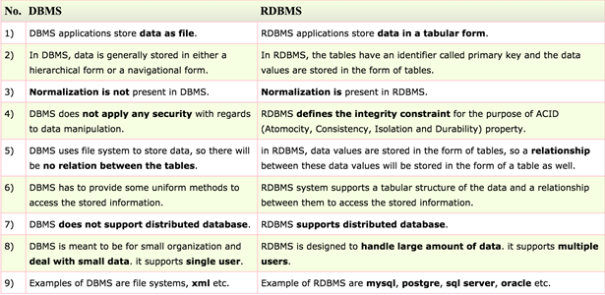
Introduction to DBMS, RDBMS and NoSQL
Difference between DBMS and RDBMS

Slide 7
Introduction to DBMS, RDBMS and NoSQL
NoSQL Database Management Systems
NoSQL databases and management systems are relation-less (or schema-less) Example:
Cassandra
MongoDB
Couchbase

Slide 8
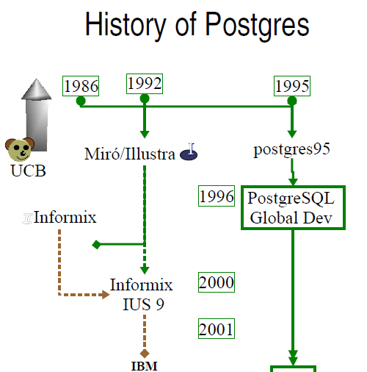
History of PostgreSQL
Created by Michael Stonebraker
Its predecessor is Ingres (1977 to 1985) which is a database system according to classic RDBMS theory.

Slide 9
Introduction to PostgreSQL
It is a object oriented relational database management system
It is a open-source.
Versions
9.5.1, 9.4.6, 9.3.11, 9.2.15, 9.1.20 and 9.0.23
OS support
Linux
Windows
Mac OS X
Solaris
Installation
URL: http://www.postgresql.org/download/
Methods:
Executable
Zip archive

Slide 10
Introduction to PostgreSQL
Why PostgreSQL
Switching database server between different OS.
It’s an open source and can be customized.
Supported by AWS.
Multi-Version Concurrency Control
Multiple procedural language support.
Flexible data type.
Object oriented.

Slide 11
Introduction to PostgreSQL
Tools
PostgreSQL Maestro
It is the premier PostgreSQL GUI admin tool for database management, control and development.
Key features includes
Support for all the PostgreSQL server versions from 7.3
Easy database object management
Database Designer
PL/pgSQL Debugger
Comfortable access to PostgreSQL security features
Data management: editing, grouping, sorting and filtering abilities
Handy SQL Editor with code folding and multi-threading
Visual Query Builder with support for subqueries and UNIONS
Working with remote PostgreSQL servers via SSH or HTTP tunnel
Data export/import to/from the most popular formats
Powerful BLOB Viewer/Editor.

Slide 12
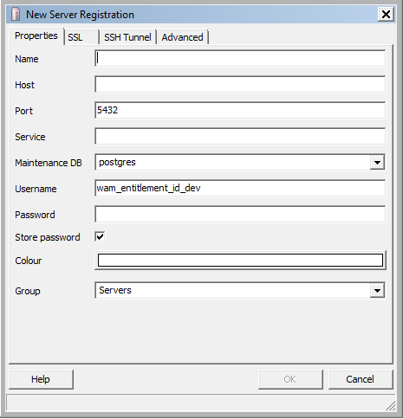
Introduction to PostgreSQL
Tools
pgAdmin
It is the most popular and feature rich Open Source administration .
Multi OS support (Linux, FreeBSD, Solaris, Mac OSX and Windows platforms).

Slide 13
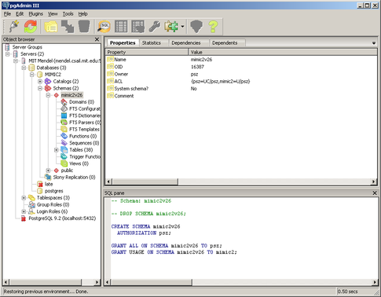
Introduction to PostgreSQL
pgAdmin

Slide 14
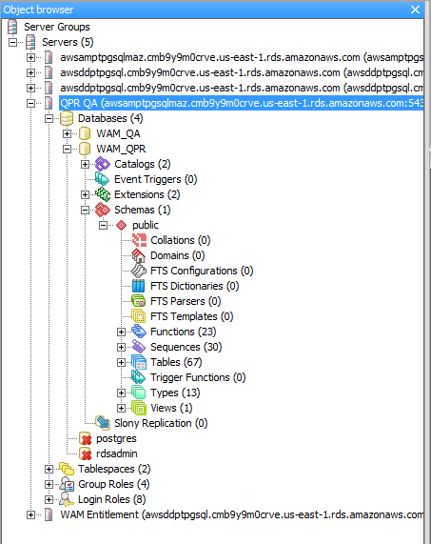
Introduction to PostgreSQL
pgAdmin object explorer

Slide 15
Datatypes
Types
Primitive Data Types
– Integers, floating points, booleans, characters
Primitive Data Structures
– Arrays, linked lists, hash tables
Data Structures++
– Classes, structs, trees

Slide 16
Datatypes
Numeric types
Name | Storage Size | Description | Range
smallint, int2 | 2 bytes | small-range integer | -32768 to +32767
integer, int, int4 | 4 bytes | typical choice for integer | -2147483648 to +2147483647
bigint, int8 | 8 bytes | large-range integer | -9223372036854775808 to 9223372036854775807
decimal [ (p,s) ] | variable | user-specified precision, exact | up to 131072 digits before the decimal point; up to 16383 digits after the decimal point
numeric [ (p,s) ] | variable | user-specified precision, exact | up to 131072 digits before the decimal point; up to 16383 digits after the decimal point
real, float4 | 4 bytes | variable-precision, inexact | 6 decimal digits precision
double precision, float8 | 8 bytes | variable-precision,inexact | 15 decimal digits precision
money | 8 bytes | currency amount | -92233720368547758.08 to +92233720368547758.07

Slide 17
Datatypes
Serial types
Name | Storage Size | Description | Range
serial | 4 bytes | autoincrementing integer | 1 to 2147483647
bigserial | 8 bytes | large autoincrementing integer | 1 to 9223372036854775807

Slide 18
Datatypes
Serial types
CREATE TABLE ClientProfile ( ProfileId serial, ClientName text);
OR
CREATE SEQUENCE ClientProfile_id_seq;
CREATE TABLE ClientProfile (ProfileId integer NOT NULL DEFAULT nextval(‘awesome_id_seq’));
ALTER SEQUENCE name [ INCREMENT [ BY ] increment ]
[ MINVALUE minvalue | NO MINVALUE ]
[ MAXVALUE maxvalue | NO MAXVALUE ]
[ START [ WITH ] start ]
[ RESTART [ [ WITH ] restart ] ] [ CACHE cache ] [ [ NO ] CYCLE ]
[ OWNED BY { table.column | NONE } ]
ALTER SEQUENCE name RENAME TO new_name;

Slide 19
Datatypes
Serial Functions
nextval
advances sequence and returns new value
SELECT nextval('sequence_name');
setval
sets the current value of the sequence SELECT
setval('sequence_name', 2); -- nextval returns 3
setval('sequence_name', 2, false); -- nextval returns 2
currval
returns current value of sequence if sequence has been manipulated in session
SELECT currval('sequence_name');
lastval
returns current value of last sequence that has been manipulated in session
SELECT lastval();

Slide 20
Datatypes
Character Types
Name | Description
character varying(n), varchar(n) | variable-length with limit
character(n), char(n) | fixed-length, blank padded
text | variable unlimited length (PostgreSQL-specific, not in SQL standard)

Slide 21
Datatypes
Date / Time Types
Name | Storage Size | Description | Low Value | High Value
timestamp [(p)] [without time zone ] | 8 bytes | both date and time (no time zone) | 4713 BC | 294276 AD
timestamp [(p) ] with time zone | 8 bytes | both date and time, with time zone | 4713 BC | 294276 AD
date | 4 bytes | date (no time of day) | 4713 BC | 5874897 AD
time [ (p)] [ without time zone ] | 8 bytes | time of day (no date) | 0:00:00 | 24:00:00
time [ (p)] with time zone | 12 bytes | times of day only, with time zone | 00:00:00+1459 | 24:00:00-1459
interval [fields ] [(p) ] | 16 bytes | time interval | -178000000 years | 178000000 years

Slide 22
Datatypes
Data Types - Miscellaneous
Name | Aliases | Description
bit [ (n) ] |  | fixed-length bit string
bit varying [ (n) ] | varbit | variable-length bit string
boolean | bool | logical Boolean (true/false)
interval [ fields ] [ (p) ] |  | time span
json |  | JSON data
xml |  | XML data

Slide 23
Datatypes
Enumerated Types
Declaring ENUM
CREATE TYPE enum_eye_color AS ENUM ('blue', 'brown', 'gray', 'green');
ALTER TYPE enum_eye_color ADD VALUE 'amber‘ BEFORE 'blue';
Using ENUM
CREATE TABLE suspect (name TEXT, eye_color enum_eye_color);
INSERT INTO suspect VALUES ('John Doe', 'brown');

Slide 24
Datatypes
Arrays
CREATE TABLE person ( full_name text, sports text[], cars text[][], numbers int[3], incomes int ARRAY[4], phrases text ARRAY);
INSERT INTO person VALUES ('Rocky Bama', '{“baseball”,”basketball”}', '{{"Toyota","Prius"},{"Chevy","Tahoe"}}');
INSERT INTO person VALUES ('Rocky Bama', ARRAY['baseball','basketball'], ARRAY[['Toyota','Prius'], ['Chevy','Tahoe']]);
SELECT * FROM person WHERE sports[1] = 'baseball';

Slide 25
Datatypes
JSON
There are two JSON data types:
JSON and JSONB
JSON | JSONP
preserve semantically-insignificant white space between data | does not preserve white space
keep duplicate object keys | does not keep duplicate object keys

Slide 26
Datatypes
JSON Operators
Operator | Right Operand Type | Description | Example | Example Result
-> | int | Get JSON array element (indexed from zero, negative integers count from the end) | '[{"a":"foo"},{"b":"bar"},{"c":"baz"}]'::json->2 | {"c":"baz"}
-> | text | Get JSON object field by key | '{"a": {"b":"foo"}}'::json->'a' | {"b":"foo"}
->> | int | Get JSON array element as text | '[1,2,3]'::json->>2 | 3
->> | text | Get JSON object field as text | '{"a":1,"b":2}'::json->>'b' | 2
#> | text[] | Get JSON object at specified path | '{"a": {"b":{"c": "foo"}}}'::json#>'{a,b}' | {"c": "foo"}
#>> | text[] | Get JSON object at specified path as text | '{"a":[1,2,3],"b":[4,5,6]}'::json#>>'{a,2}' | 3

Slide 27
Datatypes
Additional JSONP Operators
Operator | Right Operand Type | Description | Example
@> | jsonb | Does the left JSON value contain the right JSON path/value entries at the top level? | '{"a":1, "b":2}'::jsonb @> '{"b":2}'::jsonb
<@ | jsonb | Are the left JSON path/value entries contained at the top level within the right JSON value? | '{"b":2}'::jsonb <@ '{"a":1, "b":2}'::jsonb
? | text | Does the string exist as a top-level key within the JSON value? | '{"a":1, "b":2}'::jsonb ? 'b'
?| | text[] | Do any of these array strings exist as top-level keys? | '{"a":1, "b":2, "c":3}'::jsonb ?| array['b', 'c']
?& | text[] | Do all of these array strings exist as top-level keys? | '["a", "b"]'::jsonb ?& array['a', 'b']

Slide 28
Datatypes
Composite Types
CREATE TYPE address AS ( street TEXT, city TEXT, state TEXT, zip CHAR(10) );
CREATE TABLE customer ( full_name TEXT, mail_address address );

Slide 29
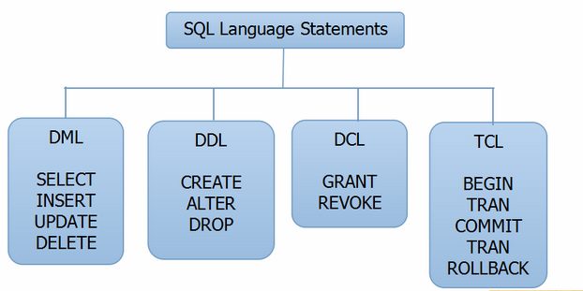
SQL statements
Types
Data Definition Language (DDL) Statements
Data Manipulation Language (DML) Statements
Data Control Language (DCL) Statements
Transaction Control Language (TCL) Statements

Slide 30
SQL statements
Data Definition Language (DDL) Statements
Statement | Description
CREATE | Create new database/table.
ALTER | Modifies the structure of database/table.
DROP | Deletes a database/table.
TRUNCATE | Remove all table records including allocated table spaces.
RENAME | Rename the database/table.

Slide 31
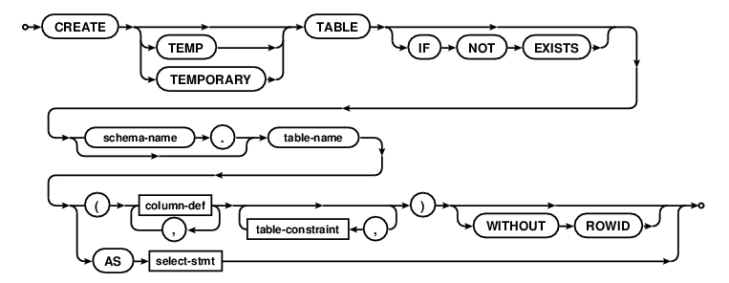
SQL statements
Create

Slide 32
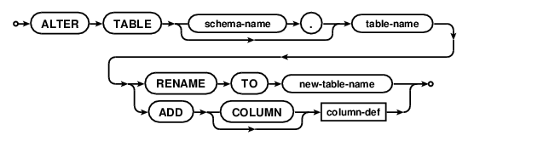
SQL statements
Alter

Slide 33
SQL statements
Drop

Slide 34
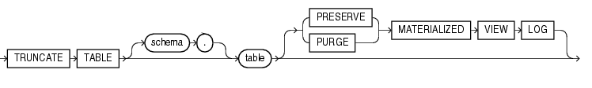
SQL statements
Truncate

Slide 35
SQL statements
Data Manipulation Language (DML) Statements
Statement | Description
SELECT | Retrieve data from the table.
INSERT | Insert data into a table.
UPDATE | Updates existing data with new data within a table.
COPY | Copies the data from a file into a table.
DELETE | Deletes the records rows from the table.
MERGE | MERGE (also called UPSERT) statements to INSERT new records or UPDATE existing records depending on condition matches or not.

Slide 36
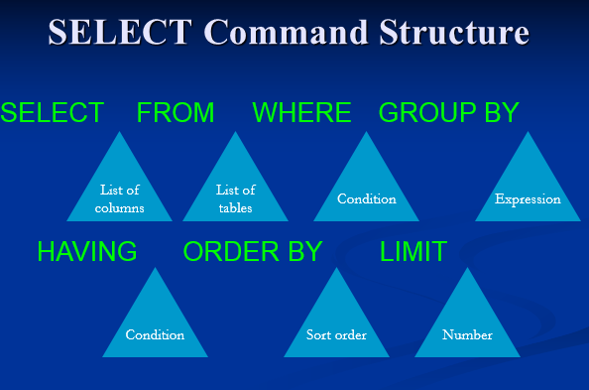
SQL statements
SELECT

Slide 37
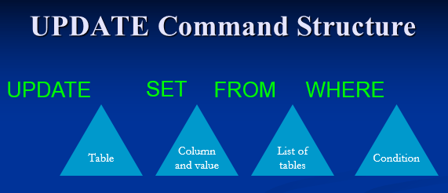
SQL statements
UPDATE

Slide 38
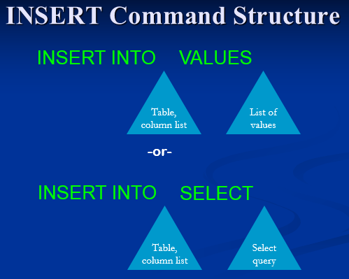
SQL statements
INSERT

Slide 39
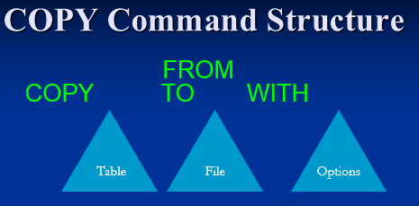
SQL statements
COPY
where option can be one of:
FORMAT format_name
OIDS [ boolean ]
DELIMITER 'delimiter_character'
NULL 'null_string'
HEADER [ boolean ]
QUOTE 'quote_character'
ESCAPE 'escape_character'
FORCE_QUOTE { ( column [, ...] ) | * }
FORCE_NOT_NULL ( column [, ...] ) |

Slide 40
SQL statements
Data Control Language (DCL) Statements
Statement | Description
GRANT | Gives privileges to user for accessing database data.
REVOKE | Take back for given privileges.

Slide 41
SQL statements
Data Control Language (DCL) Statements
GRANT SELECT, INSERT, UPDATE, DELETE ON ALL TABLES IN SCHEMA public TO user_name;
REVOKE ALL ON ALL TABLES IN SCHEMA public FROM PUBLIC;
ALTER DEFAULT PRIVILEGES FOR USER some_user IN SCHEMA public GRANT SELECT, INSERT, UPDATE, DELETE ON TABLES TO user_name;
Grant all privileges on database dbname to dbuser;

Slide 42
SQL statements
Transaction Control Statement (TCS)
Statement | Description
COMMIT | Permanent work save into database.
ROLLBACK | Restore database to original form since the last COMMIT.
SAVEPOINT | Create SAVEPOINT for later use ROLLBACK the new changes.

Slide 43
SQL statements
Transaction Control Statement (TCS)
BEGIN;
INSERT INTO table1 VALUES (3);
SAVEPOINT my_savepoint;
INSERT INTO table1 VALUES (4);
RELEASE SAVEPOINT my_savepoint;
COMMIT;

Slide 44
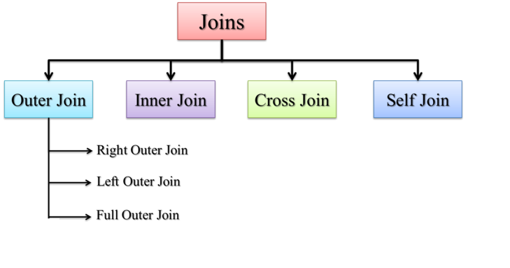
SQL statements
JOINS

Slide 45
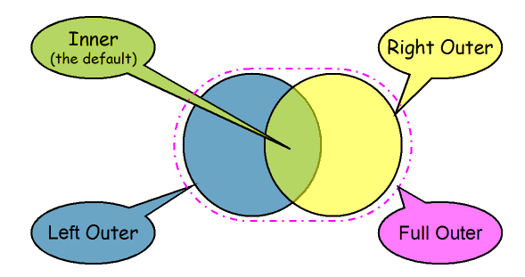
SQL statements
INNER and OUTER JOINS

Slide 46
Predefined Functions
Aggregate Functions
Name | Description
COUNT | COUNT aggregate function is used to count the number of rows in a database table
MAX | MAX aggregate function allows us to select the highest (maximum) value for a certain column
MIN | MIN aggregate function allows us to select the lowest (minimum) value for a certain column.
AVG | AVG aggregate function selects the average value for certain table column
SUM | SUM aggregate function allows selecting the total for a numeric column
ARRAY_AGG | ARRAY aggregate function puts input values, including nulls, concatenated into an array

Slide 47
Predefined Functions
Numeric Functions
Name | Description
ABS() | Returns the absolute value of numeric expression.
CEIL() | Returns the smallest integer value that is not less than passed numeric expression
CEILING() | Returns the smallest integer value that is not less than passed numeric expression
COS() | Returns the cosine of passed numeric expression. The numeric expression should be expressed in radians.
COT() | Returns the cotangent of passed numeric expression.
DEGREES() | Returns numeric expression converted from radians to degrees.
EXP() | Returns the base of the natural logarithm (e) raised to the power of passed numeric expression.
FLOOR() | Returns the largest integer value that is not greater than passed numeric expression.
GREATEST() | Returns the largest value of the input expressions.
LEAST() | Returns the minimum-valued input when given two or more.
LOG() | Returns the natural logarithm of the passed numeric expression.
MOD() | Returns the remainder of one expression by diving by another expression.

Slide 48
Predefined Functions
String Functions
Name | Description
BIT_LENGTH() | Returns length of argument in bits
CHAR_LENGTH() | Returns number of characters in argument
CONCAT() | Returns concatenated string
LCASE() | Synonym for LOWER()
LEFT() | Returns the leftmost number of characters as specified
LENGTH() | Returns the length of a string in bytes
LOWER() | Returns the argument in lowercase
LPAD() | Returns the string argument, left-padded with the specified string
LTRIM() | Removes leading spaces
MID() | Returns a substring starting from the specified position
POSITION() | A synonym for LOCATE()
REPLACE() | Replaces occurrences of a specified string
REVERSE() | Reverse the characters in a string
RIGHT() | Returns the specified rightmost number of characters
RPAD() | Appends string the specified number of times
RTRIM() | Removes trailing spaces
SUBSTRING(), SUBSTR() | Returns the substring as specified
TRIM() | Removes leading and trailing spaces
UCASE() | Synonym for UPPER()
UPPER() | Converts to uppercase

Slide 49
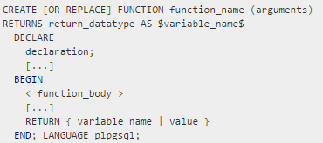
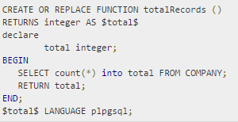
Custom Functions
Syntax
Example

Slide 50
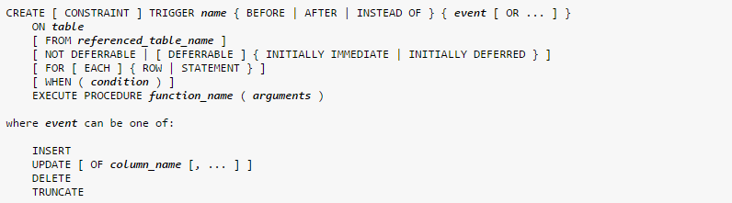
Triggers
Syntax

Slide 51
Indexes
Syntax

Slide 52
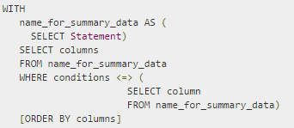
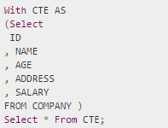
Using Common Table Expressions (CTE)
Syntax
Example

Slide 53
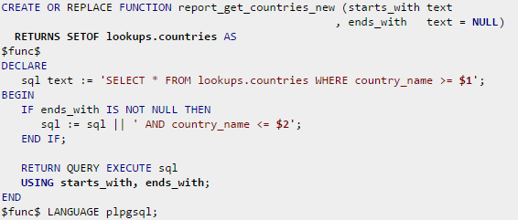
Dynamic SQL
Syntax
Example

Slide 54
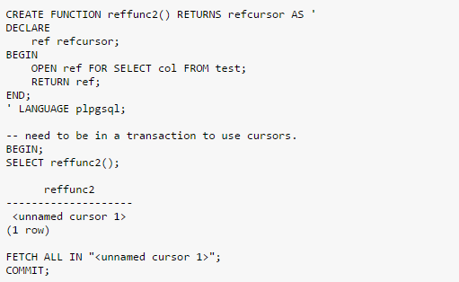
Cursors
Example

Slide 55

.Net Integration with PostgreSQL
Prerequisites
Install the setup (Setup_Npgsql-2.2.5.0-net45.exe) in the local machine which can be downloaded from the below path.
https://github.com/npgsql/npgsql/releases/download/v2.2.5/Setup_Npgsql-2.2.5.0-net45.exe
Npgsql 2.2.5 – Is a .Net data provider for Postgresql.
Different approaches to call postgresql queries and functions from c# code:
ADO .Net
Referencing the Npgsql 2.2.5 through nuget package manager console.

Slide 56
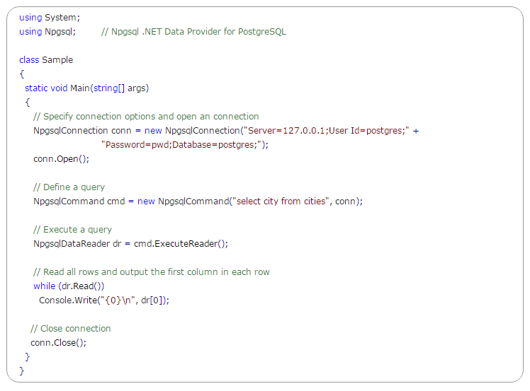
.Net Integration with PostgreSQL
Code sample

Slide 57
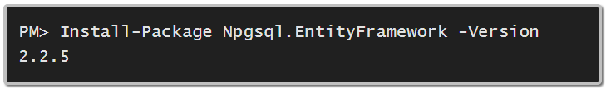
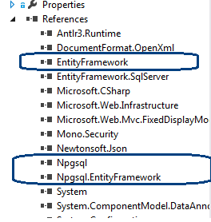
.Net Integration with PostgreSQL
Entity Framework
Referencing the Npgsql 2.2.5, EntityFramework 6.0 and Npgsql.EntityFramework 2.2.5 dlls through nuget package manager console.

Slide 58
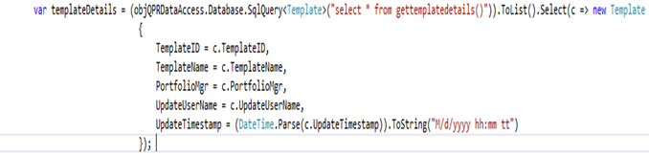
.Net Integration with PostgreSQL
Code sample

Slide 59
References
http://www.postgresql.org/docs/9.5/interactive/index.html
http://www.tutorialspoint.com/postgresql/
http://www.postgresql.org/files/documentation/pdf/9.1/postgresql-9.1-A4.pdf
https://www.pgcon.org/2013/schedule/attachments/269_tour-of-postgresql-data-types.pdf

Slide 60
Questions ?
Notes:
Blank slide or a freeform slide you may use this to insert or show screenshots etc
If content is added in this slide you will need to use bulleted text

Slide 61
Thank You
Suresh D.N. and Aravindhan D.
Notes:
Thank you slide with the customer logo:
Should have only the details shown here. Logo placement cannot be changed. Wipro logo to appear on the left as per our corporate guidelines.
Thank you– font size 30, Arial Bold
Name & Designation – font size 18, Arial normal, not to exceed beyond 2 lines
Your/contact email id – font size 18, Arial normal

